Slide 1
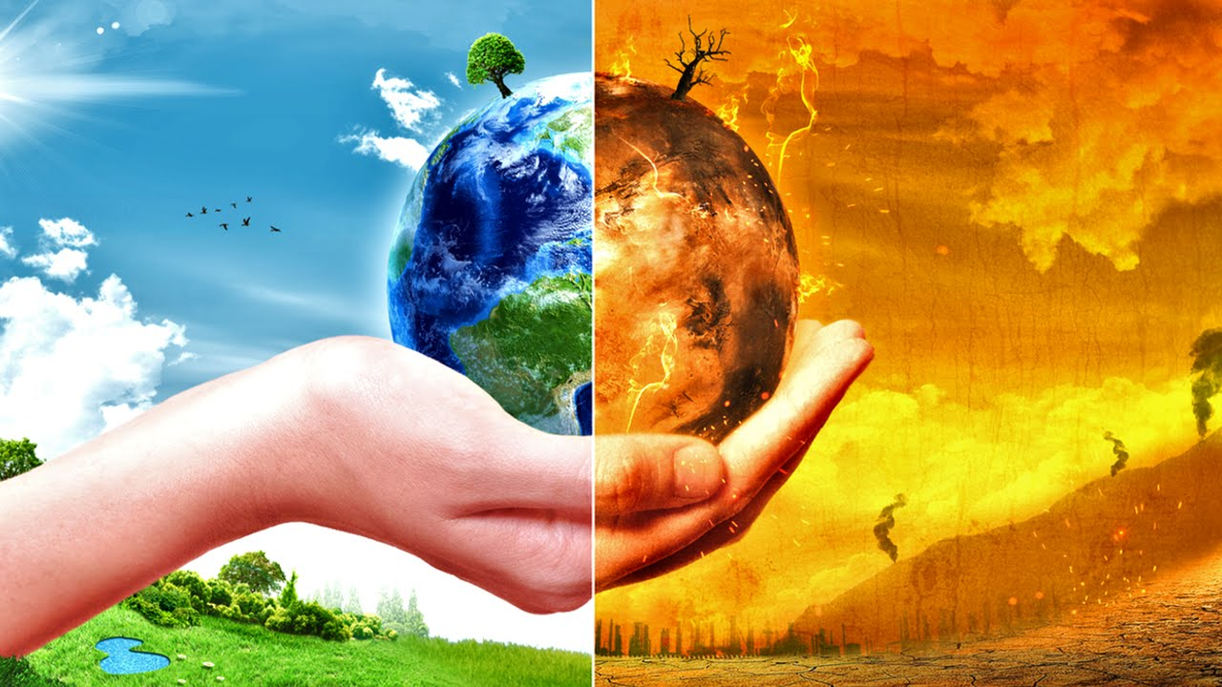
Today
Duncombe’s analysis
Resolution of General Circulation Models (GCMs)
Radiative balance + other processes
Anthropogenic impacts
Feedback loops
Things to watch out for in your GCM runs
The nature and scale of uncertainties
”The Literature is unhelpful on the issue of whether greenhouse warming is already underway...”, Nigel Bunce, 1994
“For many scientists, this is the year they started living climate change rather than just studying it. “
The New York Times, 2018

Slide 2
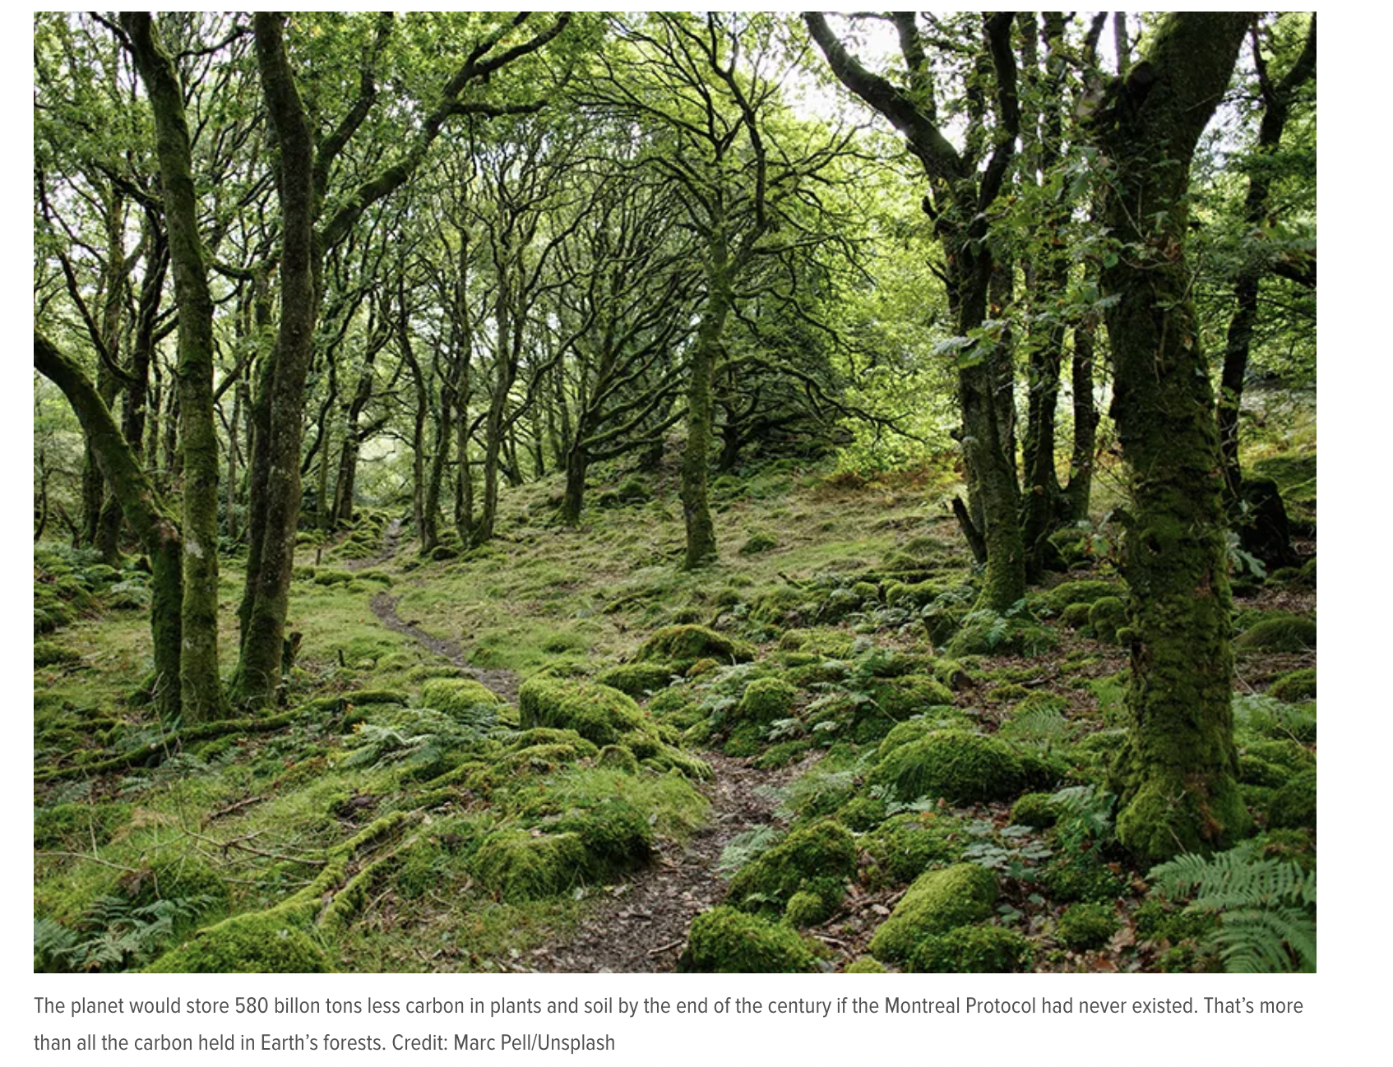
Duncombe’s analysis
How the “Best Accidental Climate Treaty” Stopped Runaway Climate Change
Jenessa Duncombe
Earth’s surface

Slide 3
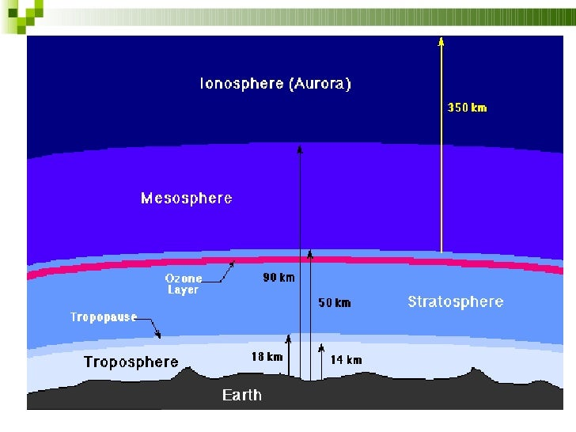
Resolution of General Circulation Models (GCMs)
The Troposphere+Stratosphere (where most of the air is) span less than 1% of Earth’s radius (~6000 km). Something like the skin of an apple.
Earth’s surface

Slide 4
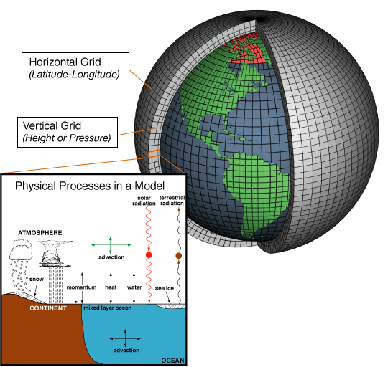
Resolution of General Circulation Models (GCMs)
Resolution:
-Time steps
-Grid Size

Slide 5
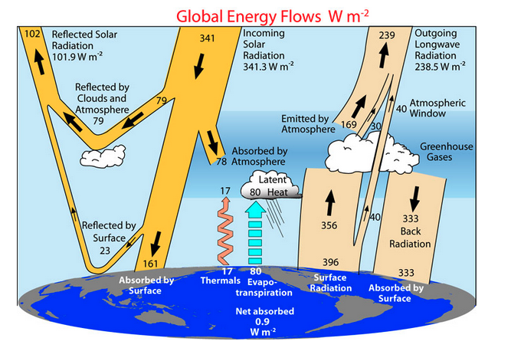
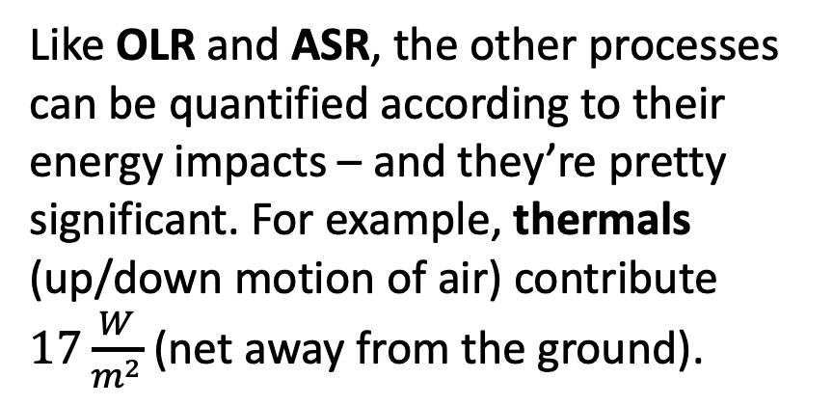
Radiative balance + other processes
Like OLR and ASR, the other processes can be quantified according to their energy impacts – and they’re pretty significant. For example, thermals (up/down motion of air) contribute $17\frac{W}{m^{2}}$ (net away from the ground).

Slide 6
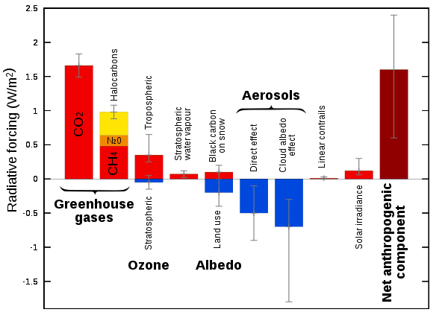
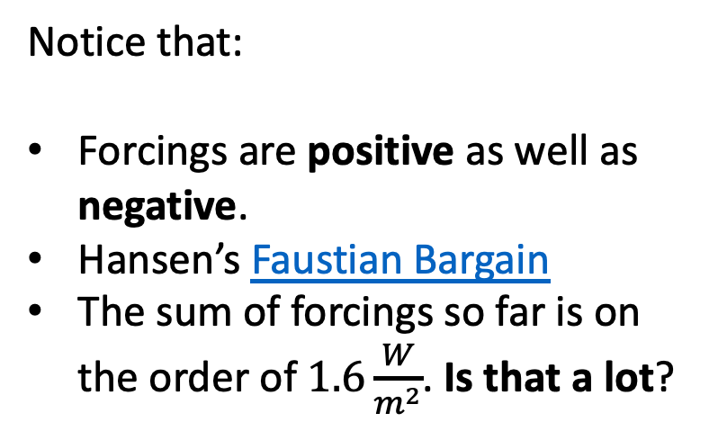
Anthropogenic impacts on radiative balance
Notice that:
Forcings are positive as well as negative.
Hansen’s Faustian Bargain
The sum of forcings so far is on the order of $1.6\frac{W}{m^{2}}$. Is that a lot?

Slide 7

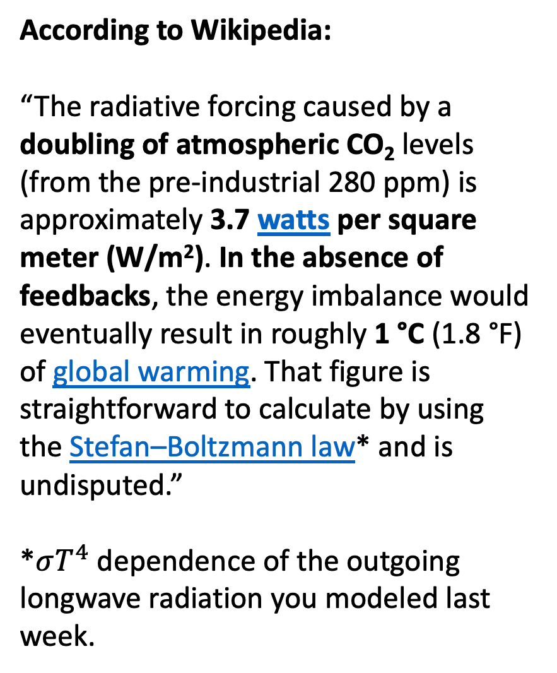
Anthropogenic impacts on radiative balance
According to Wikipedia:
“The radiative forcing caused by a doubling of atmospheric CO₂ levels (from the pre-industrial 280 ppm) is approximately 3.7 watts per square meter (W/m²). In the absence of feedbacks, the energy imbalance would eventually result in roughly 1 °C (1.8 °F) of global warming. That figure is straightforward to calculate by using the Stefan–Boltzmann law* and is undisputed.”
*$σT^{4}$ dependence of the outgoing longwave radiation you modeled last week.
So … that’s $\frac{1 ℃}{doubling CO_{2}}=0.3\frac{℃}{W/m^{2}}$

Slide 8

Anthropogenic impacts on radiative balance
According to Wikipedia:
“The radiative forcing caused by a doubling of atmospheric CO₂ levels (from the pre-industrial 280 ppm) is approximately 3.7 watts per square meter (W/m²). In the absence of feedbacks, the energy imbalance would eventually result in roughly 1 °C (1.8 °F) of global warming. That figure is straightforward to calculate by using the Stefan–Boltzmann law* and is undisputed.”
*$σT^{4}$ dependence of the outgoing longwave radiation you modeled last week.
So … that’s $\frac{1 ℃}{doubling CO_{2}}=0.3\frac{℃}{W/m^{2}}$
But that number doesn’t include feedbacks!

Slide 9
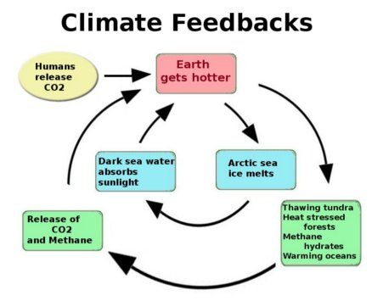
Feedback loops

Slide 10
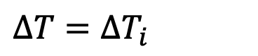
Feedback loops
$$∆T=∆T_{i}$$

Slide 11
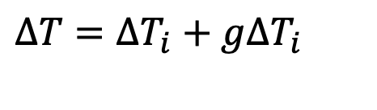

Feedback loops
$$∆T=∆T_{i}+g∆T_{i}$$
Amplified by a factor $g$

Slide 12
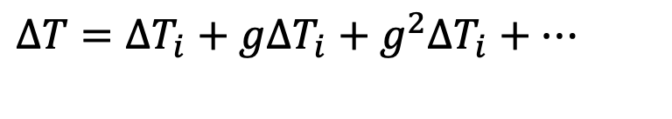
Feedback loops
$$∆T=∆T_{i}+g∆T_{i}+g^{2}∆T_{i}+…$$
Amplified by a factor $g$ again and again

Slide 13
Feedback loops
$$∆T=∆T_{i}+g∆T_{i}+g^{2}∆T_{i}+…=∆T_{i}×(1+g+g^{2}+…)$$
Factor out the initial perturbation ($∆T_{i}$)

Slide 14
Feedback loops
$$∆T=∆T_{i}+g∆T_{i}+g^{2}∆T_{i}+…=∆T_{i}×(1+g+g^{2}+…)$$
The series mathematically “converges” as long as $g<1$

Slide 15
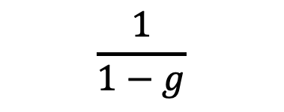
Feedback loops
$$∆T=∆T_{i}+g∆T_{i}+g^{2}∆T_{i}+…=∆T_{i}×(1+g+g^{2}+…)$$
$$\frac{1}{1−g}$$
The series mathematically “converges” as long as $g<1$

Slide 16
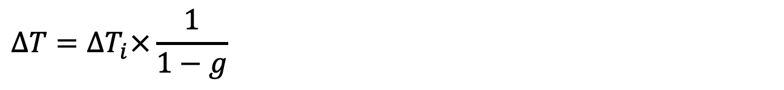
Feedback loops
$$∆T=∆T_{i}×\frac{1}{1−g}$$
So it looks like this

Slide 17
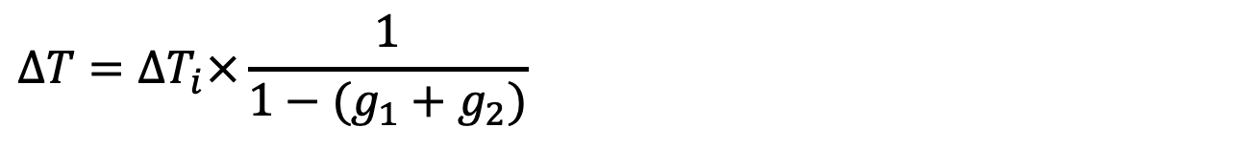
Feedback loops
$$∆T=∆T_{i}×\frac{1}{1−(g_{1}+g_{2})}$$
We can combine two feedbacks in the same way

Slide 18
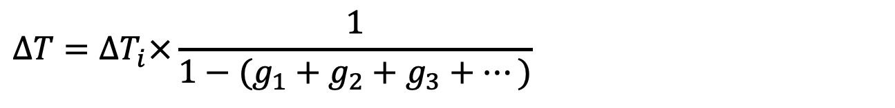
Feedback loops
$$∆T=∆T_{i}×\frac{1}{1−{(g}_{1} + g_{2}+g_{3}+…)}$$
We can combine lots of feedbacks in the same way (water vapor feedback is a big one)

Slide 19
Feedback loops
$$∆T=∆T_{i}×\frac{1}{1−{(g}_{1} + g_{2}+g_{3}+…)}$$
So what happens if the sum of feedbacks ($g_{1} + g_{2}+g_{3}+…$ ) gets bigger than 1?
Answer: the series doesn’t converge. Physically, this is ”Runaway Greenhouse” (like Venus).

Slide 20
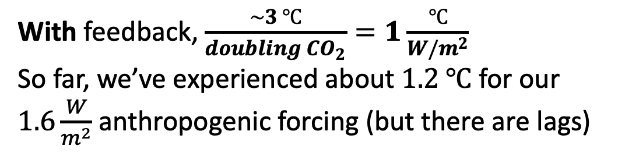
Anthropogenic impacts on radiative balance
According to Wikipedia:
“The radiative forcing caused by a doubling of atmospheric CO₂ levels (from the pre-industrial 280 ppm) is approximately 3.7 watts per square meter (W/m²). In the absence of feedbacks, the energy imbalance would eventually result in roughly 1 °C (1.8 °F) of global warming. That figure is straightforward to calculate by using the Stefan–Boltzmann law* and is undisputed.”
*$σT^{4}$ dependence of the outgoing longwave radiation you modeled last week.
With feedback, $\frac{\sim 3 ℃}{doubling CO_{2}}=1\frac{℃}{W/m^{2}}$
So far, we’ve experienced about $1.2 ℃$ for our $1.6\frac{W}{m^{2}}$ anthropogenic forcing (but there are lags)

Slide 21
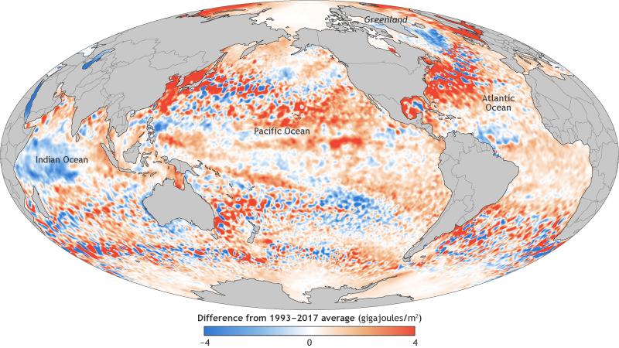
Something to watch for in your GCM runs: Geographical inhomogeneity of warming

Slide 22
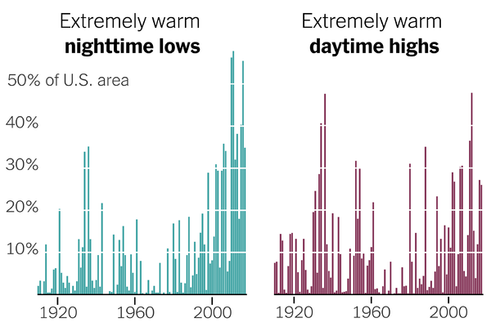
Something else to watch for in your GCM runs: Lows and highs are changing
In a typical year, heat waves kill more Americans than any other natural disaster (floods, tornadoes, or hurricanes). Data from NOAA.

Slide 23
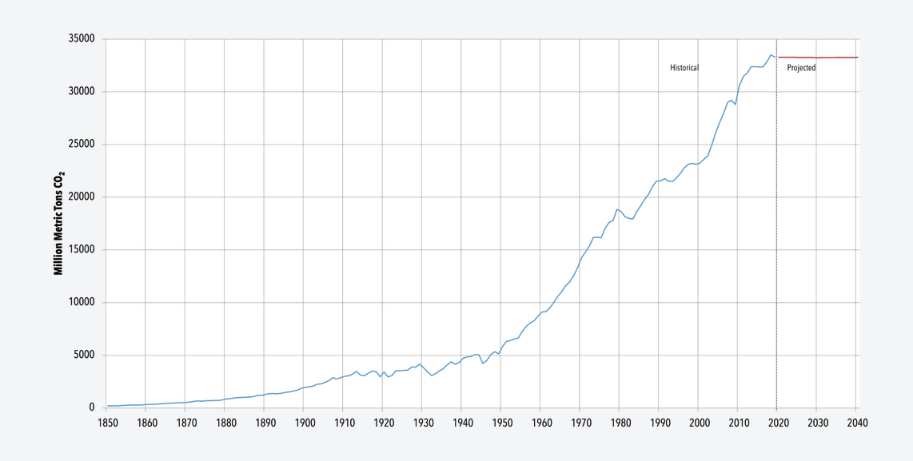
And yet something else: Units can be Carbon or CO₂
Carbon dioxide emissions
(million tons/year
Carbon emissions (million tons/year
9,000
CO₂ is about 4x higher than C
8,000
7,000
1 gigaton = 1000 million tons
1 gigaton of C = 3.67 gigaton of CO₂
1 gigaton of CO₂ = 0.27 gigaton of C

Slide 24
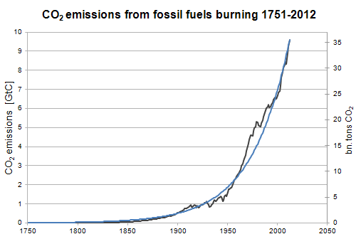
The scale of uncertainties
Past growth in emission have been more or less exponential.
Black: CDIAC data on CO₂ levels 1751-2012.
Blue: Exponential growth at rate of 2.8% per year (doubles every 25 years).

Slide 25
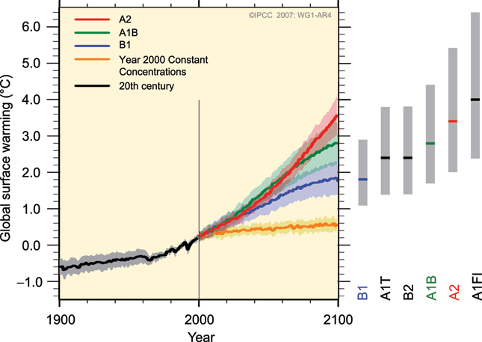
The scale of uncertainties
➔ The variation in outcomes due to uncertainty in what people decide to do, (here, B1 … A1FI) seems to be as big as uncertainties due to the physics of climate prediction.

